Slide 1
A Secured Watermarking Algorithm for Medical Images

Slide 2
Agenda
Abstract
Objectives
Literature Review
Existing System
Proposed System
System Architecture
Modules
Conclusion
References

Slide 3
Abstract
In recent years, Digitalization of information has been a method to handle data and these get transmitted through network that leads to availability of data in the public.
To overcome the difficulty of change in medical reports and unwanted personal presence by the traditional methods were introduced.
Design a security scheme to protect patient information while making the information readily accessible when necessary.
Reliability has two aspects one is authentication which authenticates that the correct patient gets accessed on an image other one with integrity which protects the images modified by an unauthorized.

Slide 4
Objectives
To design a novel method for embedding extraction
To secure the patient information
To improve the performance of the system
To reduce the error rate of the system

Slide 5
Literature Review
Amit Mehto et al., proposed a lossless embedding watermarking algorithm which uses the combined DWT-DCT algorithm embedded watermarks in original medical image.
It embeds watermark like patient’s name, disease’s name, hospital’s name, and doctor’s signature into original medical image.
Watermarking embedding process is carried out by apply DWT to decompose the original image into four non-overlapping multi resolutions sub-band (LL, LH, HL and HH).
After the decomposition of high frequency sub-band HH, apply DCT. After that find adaptive scaling factor. Embeds the watermark in the DCT of HH. Apply the IDCT and IDWT and construct the watermarked image.
Watermarking extraction process is followed by apply DWT to decompose original image and watermarked image into the four multi-resolution sub-bands (LL, LH, HL and HH).
. To extract watermark follow the same procedure extract and compare.

Slide 6
Literature Review
S.Siva Kannan et al., developed watermarking algorithm based on ICA and DWT combined approach and insertion of two independent watermark into medical image (RONI).
They separated region of interest (ROI) from medical image and from RONI image they separated that into N/2 X M/2 observation images and then they applied ICA to all the observation images.
Then choose the two components from high frequency level. Selected sub band is wavelet transformed. The two independent watermark image is embedded into the corresponding position.
Make the whole image Inverse DWT and Inverse ICA transformed and get the cover image and watermark.
Here patient fingerprint and patient data template taken as watermark. And combine the components and ROI to RONI and the resultant component was watermarked image. To extract watermark follow the same procedure extract and compare.

Slide 7
Existing System
They use formal method of watermarking technique these method gives low robustness and they embed patient data on medical images which was not promising.
The methods are very usual and these are frequently used approach in a watermarking and these been extracted easily.
There are no reliability content over the watermarking technique to safe the data from unknown person.

Slide 8
Proposed System
Embedding Process:
Convert the video into frame by frame
Apply PCA for selected frame based on the Patient id.
Apply DWT to separate the frequency band
Obtain Scale value using DCT in cover image.
Multiply the Scale value with watermark image.
Add the resultant image with HH band.

Slide 9
Proposed System
Extraction Process:
Apply PCA for selected frame based on the Patient id.
Subtract the resultant image with HH band.
Obtain Scale value using DCT in cover image.
Multiply the Scale value with watermark image.
Apply Discrete Wavelet Transform (DWT) to obtain original image

Slide 10
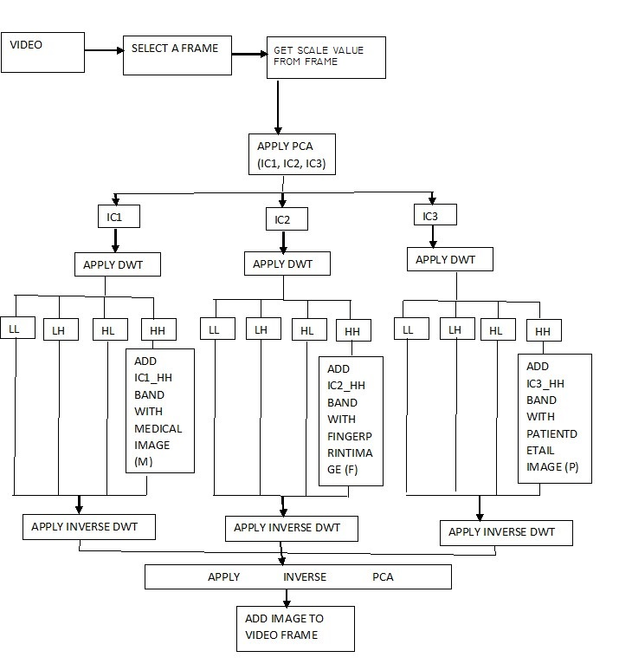
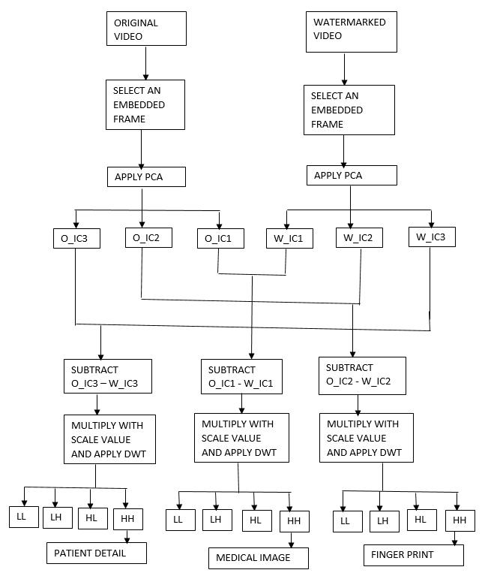
System Architecture
Embedding Process
Extraction Process

Slide 11
Modules
Embedding process
Video Embedded Frame image
Embedded function
Scale function
Extraction process
Video Extraction Frame image
Extraction function
Error function

Slide 12
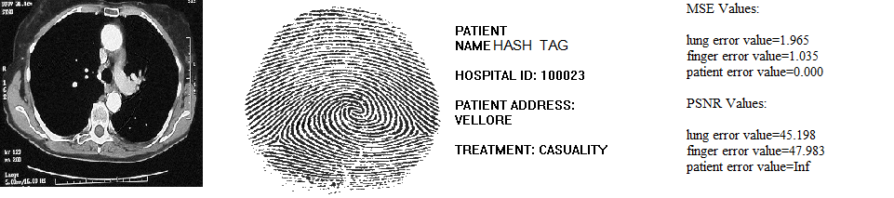
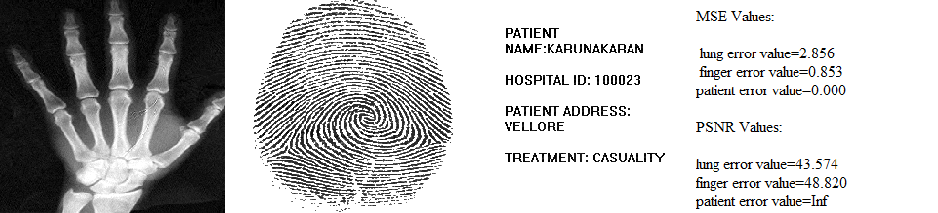
Results

Slide 13
Conclusion
The proposed algorithm of a secured watermarking algorithm for medical image is provided lossless medical image watermarking technique.
The value of PSNR for proposed work of watermark image with original image is 40 to 45 dB these provided good visualization of output.

Slide 14
References
Amit Mehto,Neelesh Mehra,”Adaptive lossless Medical Image Watermarking Algorithm Based on DCT & DWT”,”International conference on information security & privacy.
S.Siva Kannan,G.Thirugnanam and C.Sheeba Joica,”An Efficient ICA and DWT Combined Approach for Medical Image Watermarking Technique”.

